Slide 1
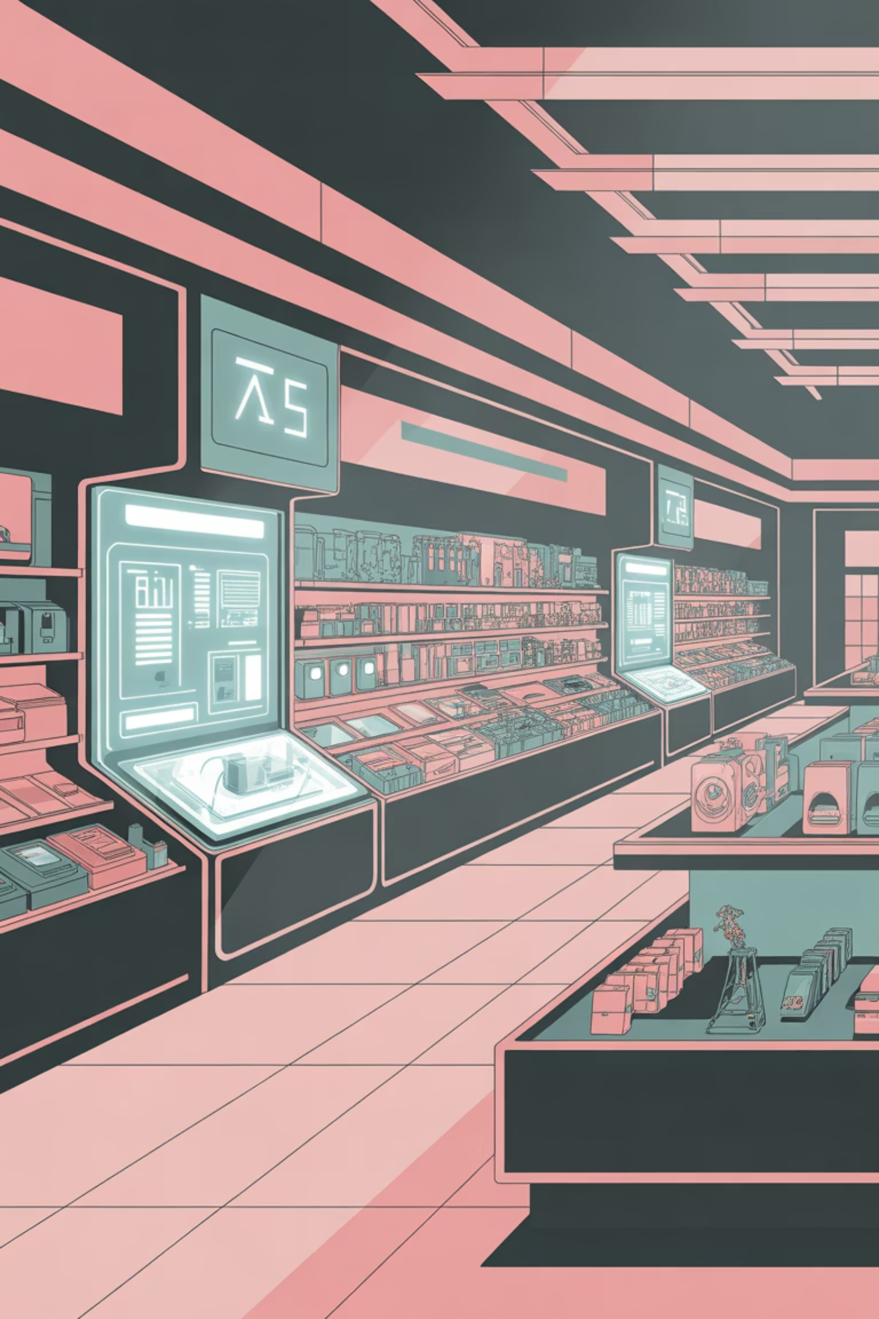
Retail Store Items Detection
A deep learning–based computer vision system to automatically detect and classify retail store items from images.

Slide 2
Project Overview
1
2
3
Object Detection
Bounding Boxes
Technical Design
Identifies multiple items in a single image.
Highlights items with bounding boxes and class labels.
Documentation covers workflow, components, and execution.
This project leverages computer vision to streamline retail operations.

Slide 3


Project Type & Core Technology
Domain
Artificial Intelligence (AI)
Sub-domain
Computer Vision
Technique
Object Detection
Model Type
CNN-based

Slide 4

System Architecture
Input
Feature Extract
Visualize
Acquire raw image data
Use CNN to derive features
Render boxes and annotations
Preprocess
Detect & Classify
Normalize and resize images
Locate objects and assign labels
The system follows a standard object detection pipeline, from image input to visual output.

Slide 5
Technology Stack
Programming Language
Python
Deep Learning
CNN-based Detection Model
Computer Vision
OpenCV
Numerical Processing
NumPy
Visualization
Matplotlib
IDE
Visual Studio Code
A robust set of tools ensures efficient development and deployment.

Slide 6

Dataset & Model
Dataset Description
Model Description
Labeled images of retail items, each with bounding boxes and class labels.
CNN-based model extracts visual features to predict object class and location.
Train Folder: For model training.
Test Folder: For evaluation and detection.
Detects multiple objects in one image.
Predicts item name and bounding box.

Slide 7



Project Modules
Training Module
Detection Module
Utility Module
Loads data, preprocesses images, trains the model, and saves weights.
Loads trained model, accepts test images, detects items, and draws boxes/labels.
Provides image loading, bounding box drawing, and helper methods.

Slide 8
Workflow & Results
Workflow
Input & Output
01
Input: Retail store images (JPEG / PNG)
Dataset Preparation
Output: Images with detected items, bounding boxes, labels, and confidence scores.
02
Results
Model Training
System successfully detects retail items with good accuracy, suitable for retail automation.
03
Model Validation
04
Detection on New Images
05
Output Visualization

Slide 9

Advantages & Limitations
Advantages
Limitations
Automates item detection
Reduces human effort
Accurate multi-object detection
Scalable solution
Limited to trained item classes
Performance depends on dataset quality
High computation requirement

Slide 10
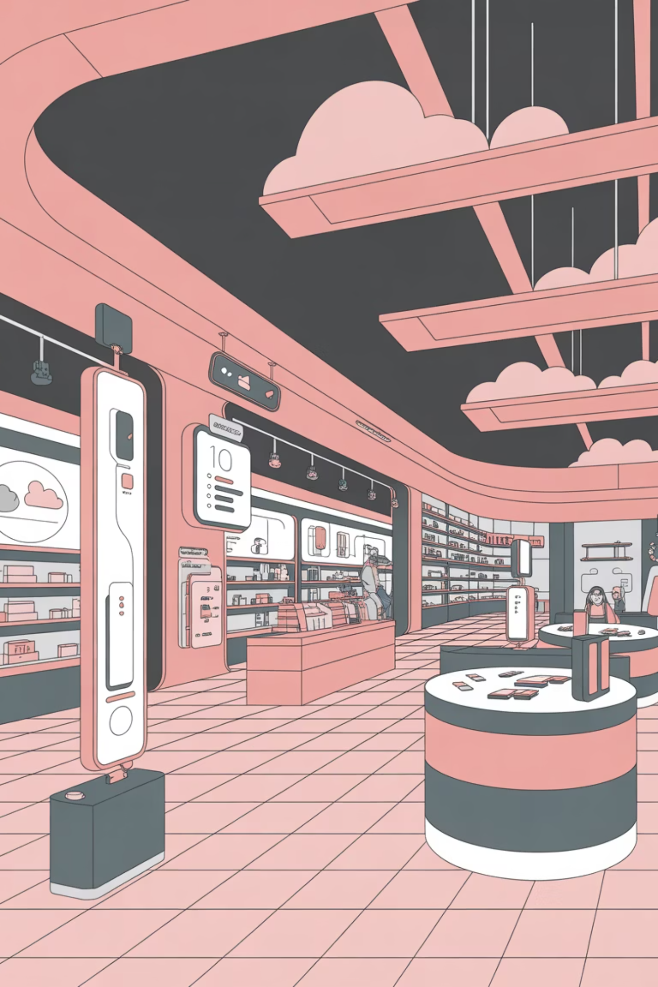
Future Enhancements & Conclusion
Future Enhancements
Conclusion
Real-time video detection
Integration with billing systems
Cloud deployment
Improved model accuracy
The Retail Store Items Detection project effectively uses deep learning and computer vision for automated retail item recognition. It is a robust, scalable solution for smart retail environments.

